Slide 1

Text Representations
Women in AI Academy and Consultancy
Nabanita Roy

Slide 2
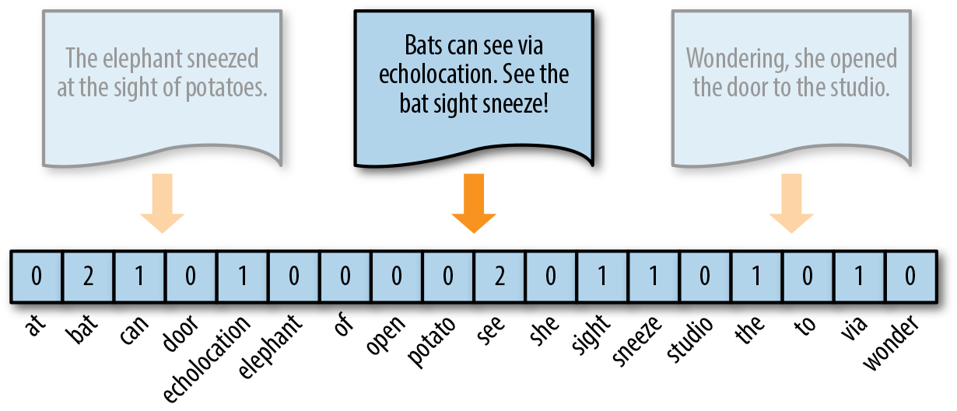
FEATURE ENGINEERING FOR TEXTS
Machine Learning
models quantifies
everything.
Therefore,
numeric representation
for texts is required
as input an ML model.
Image ref: https://towardsdatascience.com/from-word-embeddings-to-pretrained-language-models-a-new-age-in-nlp-part-1-7ed0c7f3dfc5

Slide 3
ONE HOT REPRESENTATION
A one hot vector is a vector whose elements are only 1 and 0. Therefore, it is a Boolean Model.
For a finite set of vocabulary of size N, one word will be represented as a vector of N dimension where the value at the index for that word is 1.
Context is lost and no frequency information
mouse = [ 0, 0, 1, 0 , 0]
cat = [ 0, 0, 0, 0 , 1]
chase = [0, 0, 0, 1, 0]
“The mouse was chasing the cat”
vocab = [‘the’, ‘was, ‘mouse’, ‘chase’, ‘cat’]

Slide 4
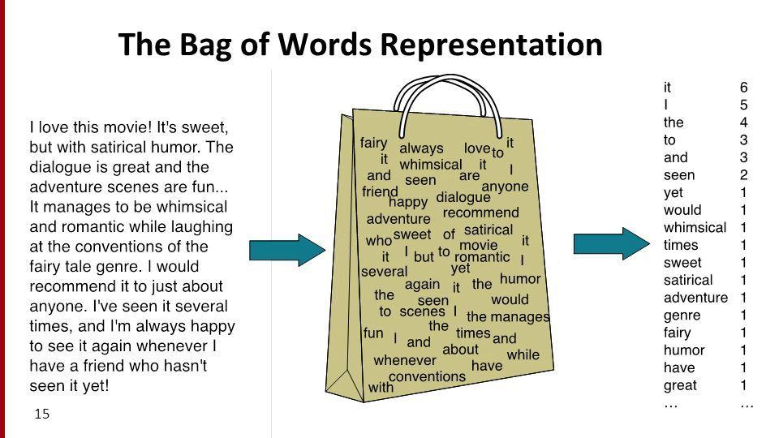
Statistical Model 2 - Bag of Words Model
Position of the words is ignored and Frequency (the number of occurrences) of a token is considered
In a Bag of Words or BoW, bag refers to an unordered list of words which allows multiple occurrences of the words
Image ref: https://web.cs.hacettepe.edu.tr/~ilyas/Courses/CMP711/lec05-TextClassificationNaiveBayes.pdf

Slide 5
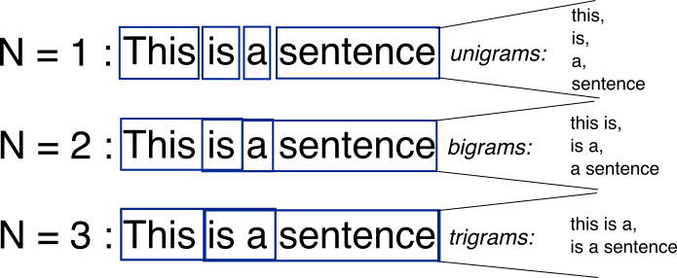
Statistical Model II - Bag of N-Grams Model
Takes into account N tokens occurring in a sequence.

Slide 6
Bag of Words Model
PROBLEM: Highly frequent words start to dominate in the document (i.e. have larger score), but may not contain as much “informational content” to the model
TF – IDF Model
SOLUTION: Rescale the frequency of words by how often they appear in all documents, so that the scores for frequent words like “the” that are also frequent across all documents are penalized.

Slide 7
Statistical Model III
Term Frequency – Inverse Document Frequency
frequency of the word in the current document
how rare the word is across documents
Tom was chasing Jerry but Jerry very fast and hid in his little hole.
Tom was beaten up by Bruno, the dog. Bruno was angry and Jerry was hiding behind the lamp.
Tom and Jerry were fighting again.
Documents are converted to vector models (or vectorized form) using the number of the times a token appears in one document and in all the documents.
Order is ignored.

Slide 8
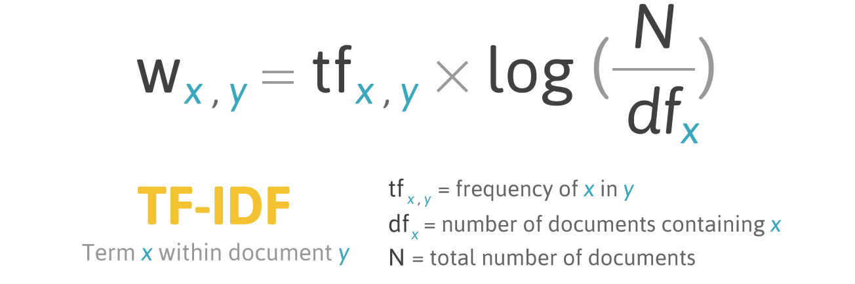
TF-IDF Formula
Use log to dampen the effect of large corpus
(df+1) is used instead for terms that do not occur in the vocabulary to avoid Zero Division.
Image ref: http://filotechnologia.blogspot.com/2014/01/a-simple-java-class-for-tfidf-scoring.html

Slide 9
Drawback of Statistical Models
Loss of semantic information
Large corpus -> large vocabulary
Large vocabulary -> sparsity
Increased memory and computing power requirements

Slide 10
Word Embeddings and Neural Models
An embedding is a dense vector of floating-point values.
Word2Vec is a family of model architectures and optimizations that can be used to learn word embeddings from large dataset.
Contextual
Similarity
Loss of semantic information
Large corpus -> large vocabulary
Large vocabulary -> sparsity
Increased memory requirements and computing power
Dense Vector Representation

Slide 11
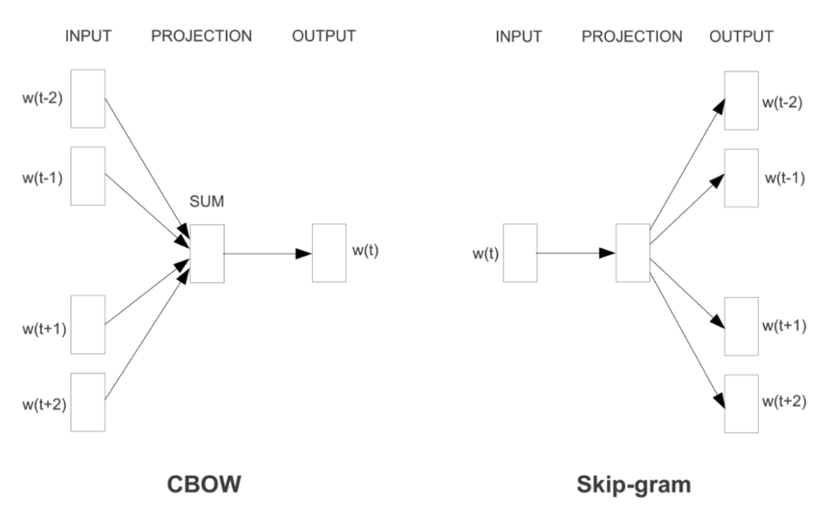
Word2Vec Model
predict words within a certain range before and after the current word in the same sentence
predicts the middle word based on surrounding context words.
Image ref: Efficient Estimation of Word Representations in Vector Space”, 2013

Slide 12
Word2Vec GlobalVectors
Window-based
->
Doesn’t take overall corpus stats
The main idea behind the GloVe model is to focus on the co-occurrence probabilities of words within a corpus of texts in order to embed them in meaningful vectors.

Slide 13
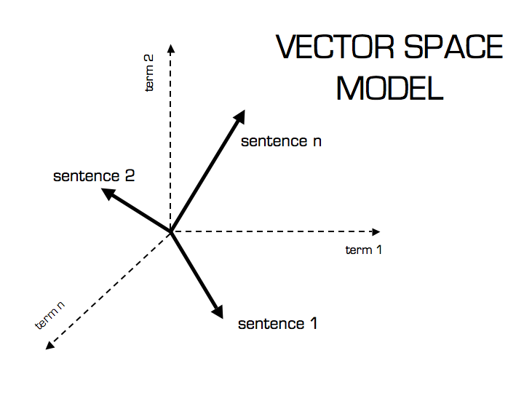
Vector Space and Vector Similarity
Represent text as vectors in a vector space
Similarity techniques allows us to identify the terms which occur in similar contexts
Euclidean Distance
Cosine Similarity
The distances in vector space isn’t semantic distance

Slide 14
Thank You
Q/A

